Slide 1
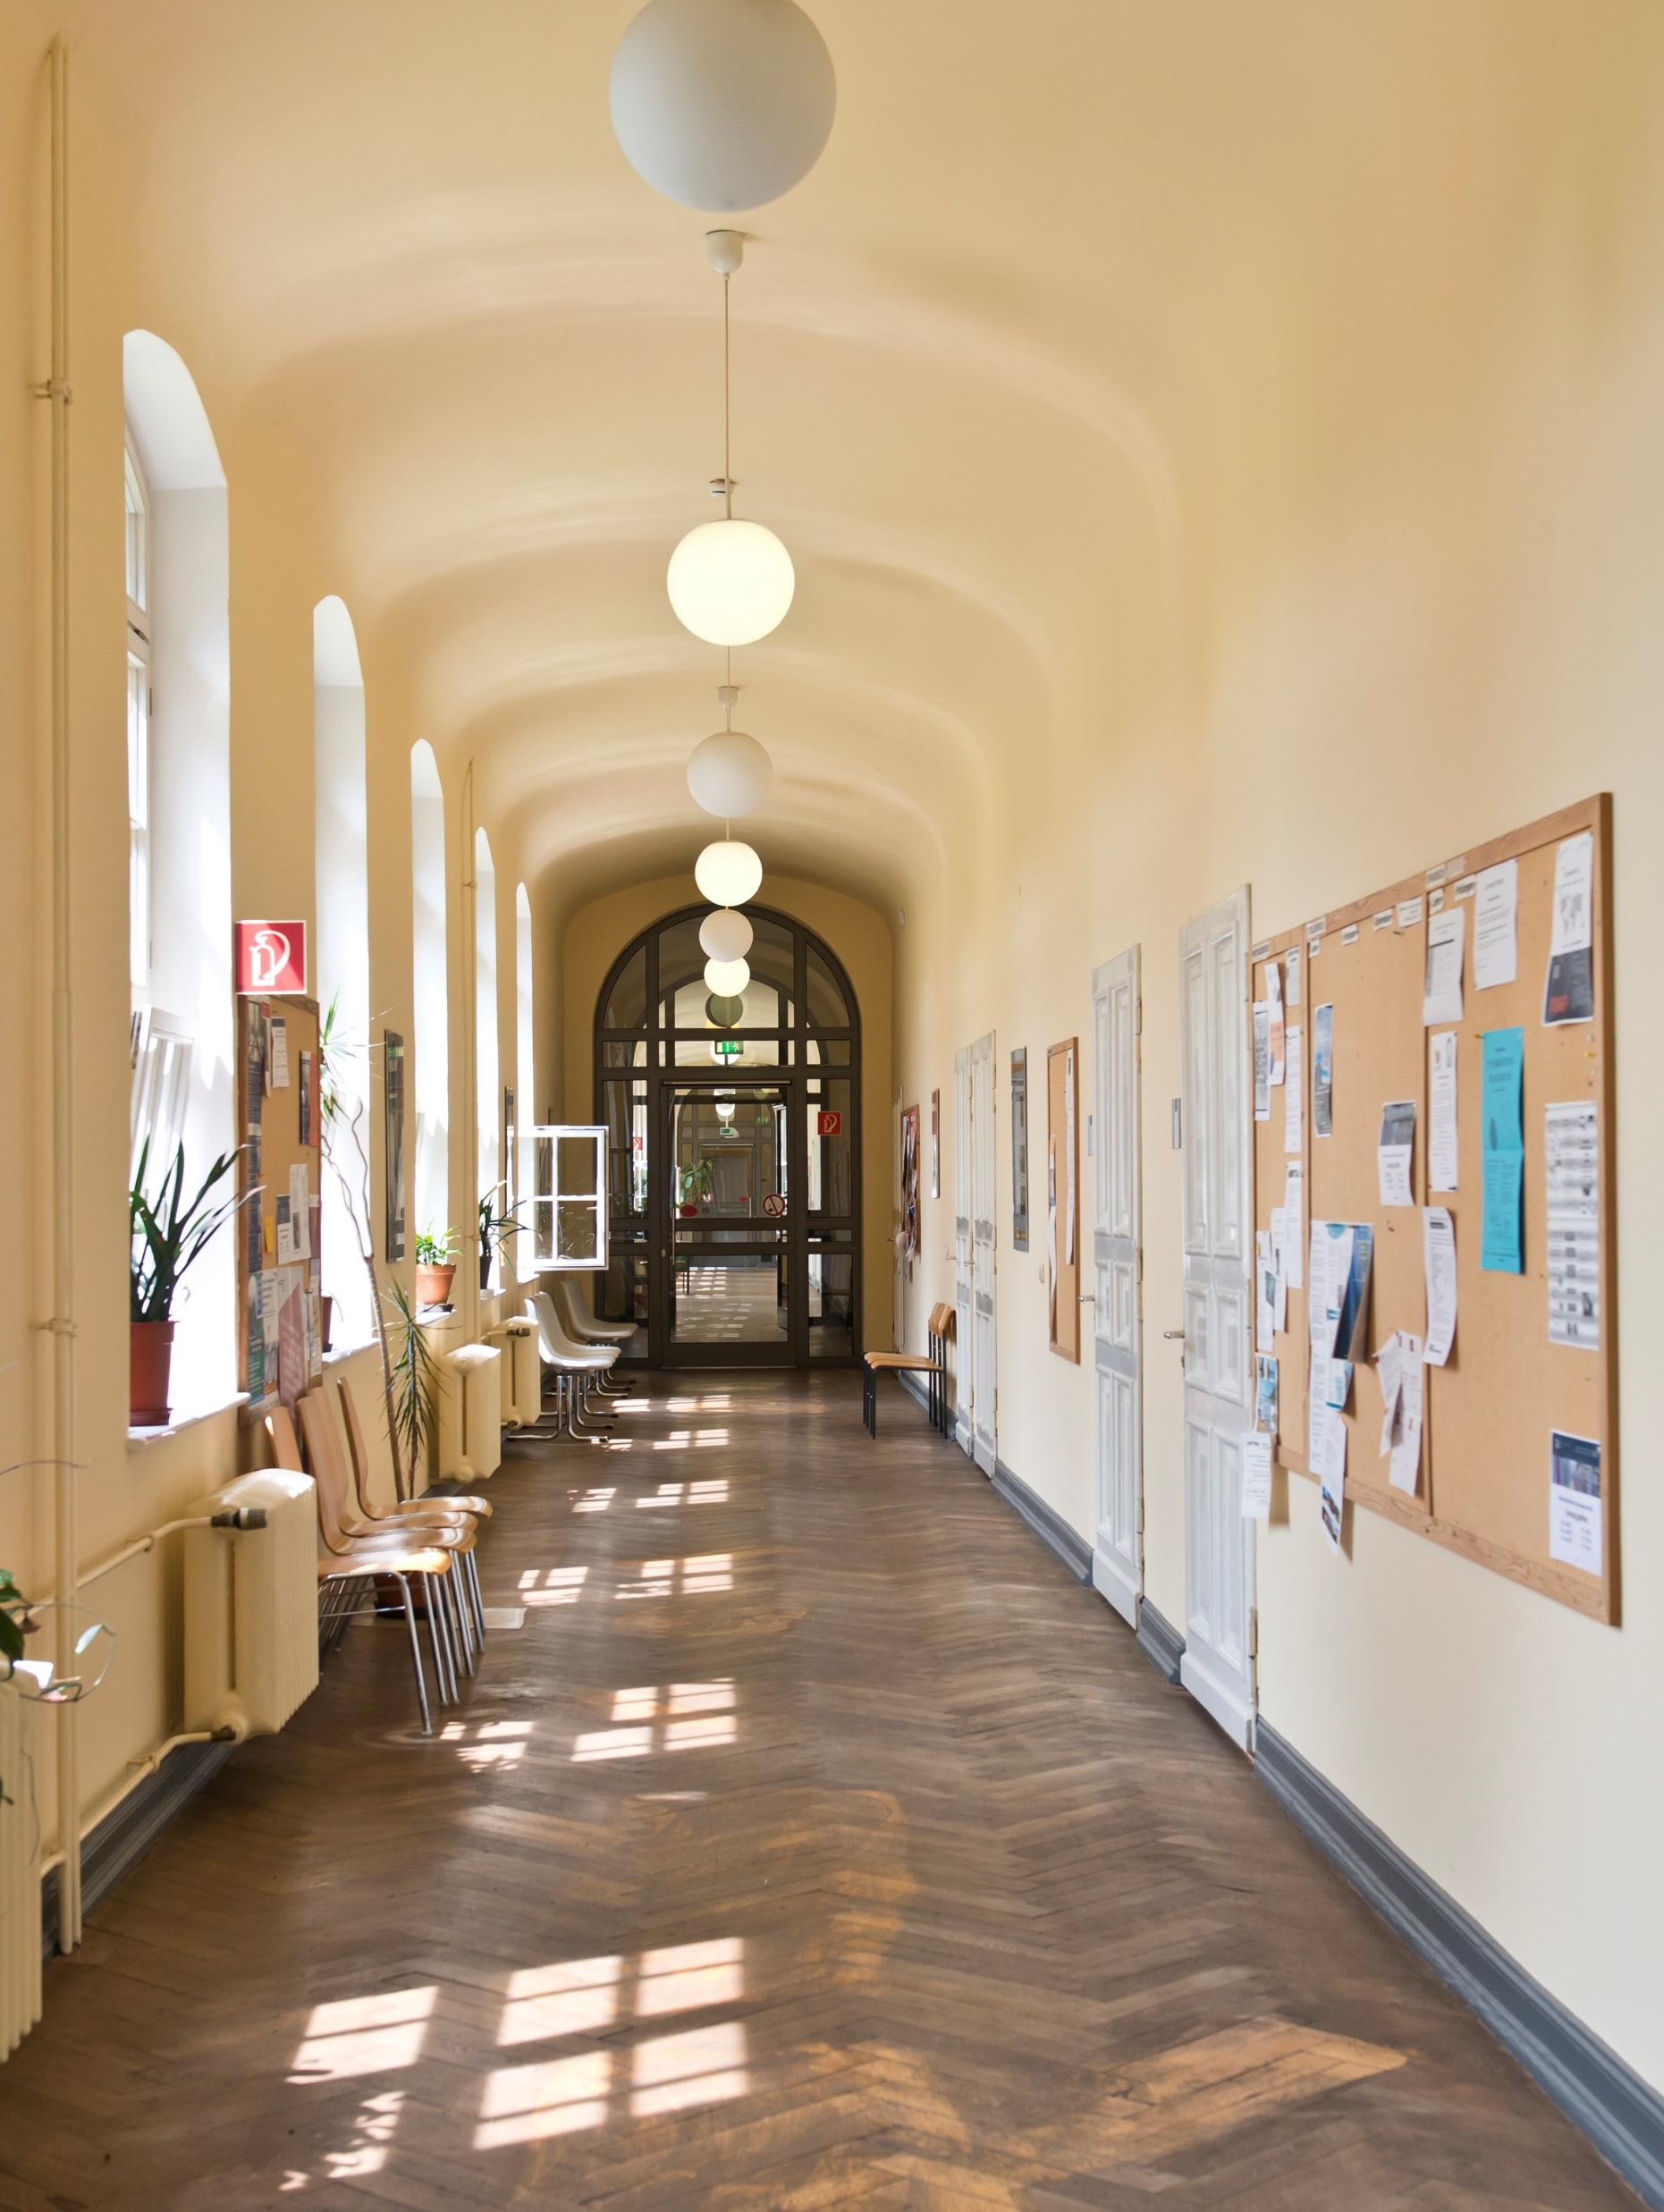
Information for Students
Dean of Studies Office Faculty of Humanities - As of winter semester 2025/26

Slide 2

Content
Information from the Examinations Office on examinations
Information on compensation for disadvantages
Schreiblabor and InDiGu-PLUS
Contact points for questions
Contact lecturer

Slide 3

Information by the Examination Office
Exam participation, examination forms, FlexNow, forms, plagiarism, links

Slide 4
Exam participation I
Students are only admitted to the examination if they…
attend the course as part of a module for which they are eligible according to their enrolment,
The admission requirements defined in the examination regulations are included in FlexNow. Students who do not meet these requirements and are therefore not entitled to take the module will be denied registration in FlexNow.

Slide 5
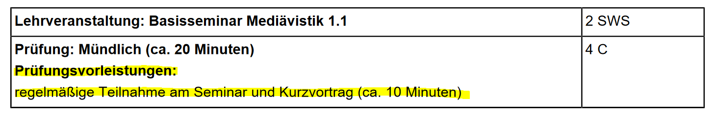
Exam participation II
Students are only admitted to the examination if they…
b) have fulfilled the examination prerequisite(s) specified in the module sheet, if required,
The preliminary examination requirements to be completed can be found on the corresponding module sheet, e.g:
Examiners enter a "rejection" for students who have registered for the examination via FlexNow but do not fulfill the prerequisites.

Slide 6
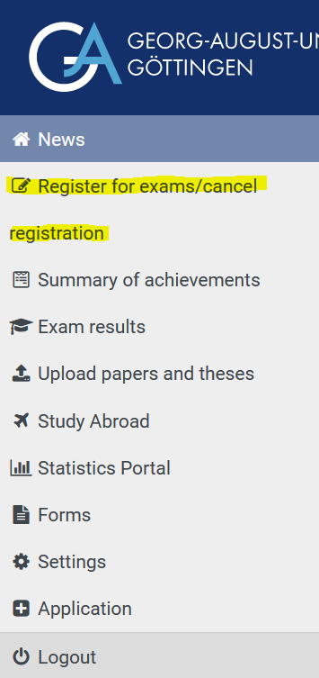
Exam participation III
Students are only admitted to the examination if they…
c) have properly registered for the examination via FlexNow .
If there is no FlexNow registration, the student must be excluded from taking the examination by the examiner.
Registration via Stud.IP does not count as exam registration.
Be sure to observe the registration and deregistration deadlines in FlexNow! Withdrawal from a registered examination is only possible within the deregistration period. Once the deregistration deadline has passed, it is no longer possible to delete the registration; instead, a "failed" is entered.

Slide 7
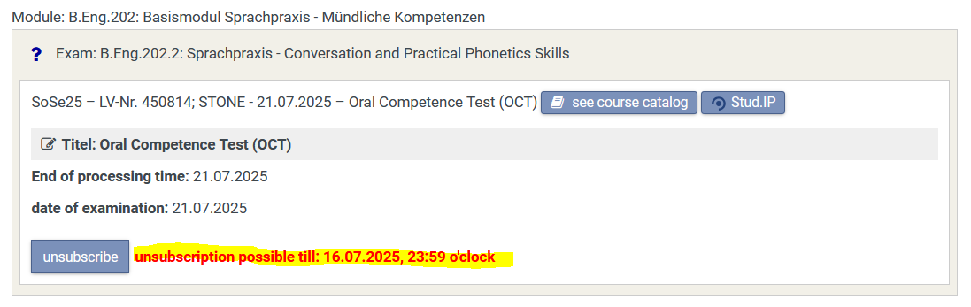
Exam participation III (cont.)
The deadline for cancelling an exam is also shown in the Flexnow account directly with the registered exam:

Slide 8
Exam participation IV
Exception:
No FlexNow registration for learning agreements in the Master's program
Master's students who have been conditionally admitted and have to make up examination components as part of a learning contract cannot and must not register for this via FlexNow.
In this case, proof that the required achievements have been fulfilled is provided with the help of the "Learning Agreement Form“, which is issued by the academic advisors: https://www.uni-goettingen.de/en/209399.html
- Important Information on application and admission procedure for M.A. students

Slide 9
Exam participation V
Students should be sure to check the course catalog (EXA) before the start of the semester to see whether the courses they plan to attend are assigned to modules that they are allowed to complete.
If students have any questions, they should contact the Examination Office Team before the registration deadline:
http://www.phil.uni-goettingen.de/examination-office-team

Slide 10
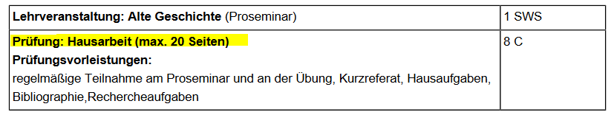
Examination forms I
The form of examination to be taken depends exclusively on the module in which the course is attended. The specifications for this are given in the corresponding module sheet:
The module sheets are part of the examination regulations and are therefore legally binding. Examiners must provide candidates with the required examination form. Deviations from this are not permitted.
Depending on which modules a course has been assigned to, participating students may therefore have to take different forms of examination.

Slide 11
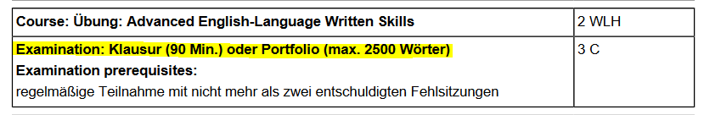
Examination forms II
If a module sheet lists several alternative forms of examination, this does not mean that students are allowed to choose. In this case, the examiner determines at the beginning of the lecture period which of these examination forms will be made available in the current semester:

Slide 12
Entry of the examination assessments
Students should regularly check whether all their examination results have been entered in FlexNow.
It is not possible to register for subsequent modules until it has been confirmed by entry that the previous module has been successfully passed.
It is also important to enter failed attempts (e.g. if no examination performance was submitted despite registration), because as long as a registration is still open, FlexNow prevents registration for a further attempt in this module.
If the examination assessment is not entered for a module, students should contact the department that offered the course. The Examination Office is not involved in the registration process and therefore has no examination results available.

Slide 13
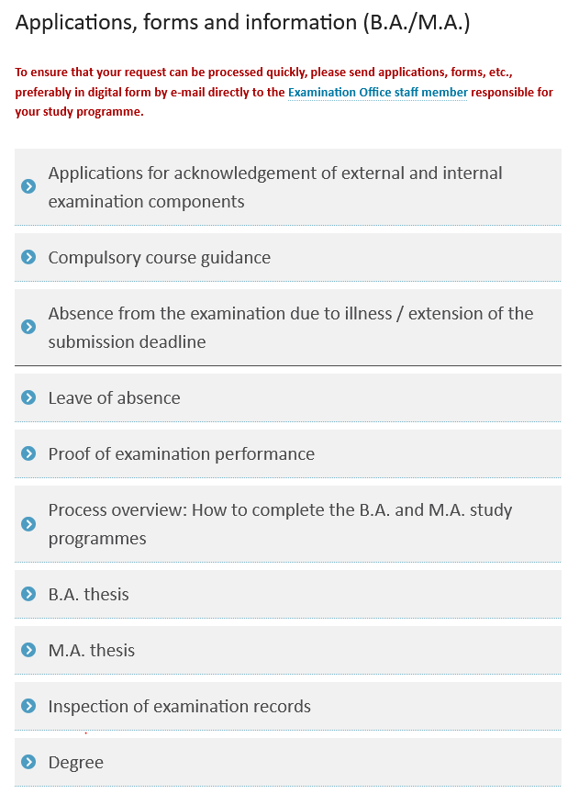
B.A. and M.A. forms of the Examination Office
On the page
www.phil.uni-goettingen.de/examination-office-forms
the Examination Office provides all important forms and information in German and English for download.

Slide 14
Plagiarism / Attempted deception / AI tools I
Plagiarism and other attempts at cheating are reported by the examiners to the Examination Office, where these incidents are recorded centrally and archived in the electronic student file.
In serious cases, the Examination Office will submit the case to the Examination Board for B.A. and M.A. Degree Programmes of the Faculty of Humanities, which will then decide whether to impose sanctions. This may result in de-registration from the study program.

Slide 15
Plagiarism / Attempted deception / AI tools II
Although the use of AI tools is generally permitted, students should be transparent about what they have used ChatGPT & Co. for and to what extent. Not doing so may be considered an attempt to cheat.
For more information, see the page
https://www.uni-goettingen.de/en/674738.html

Slide 16
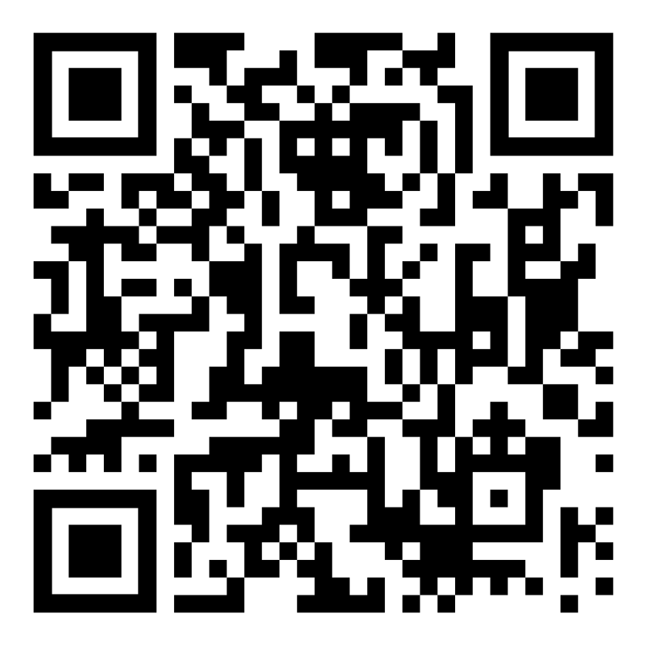
Links I
Examination Office:
http://www.phil.uni-goettingen.de/examination-office-team
Applications, forms and information (B.A./M.A.)
http://www.phil.uni-goettingen.de/examination-office-forms
Examination Office

Slide 17
Links II
Examination regulations
The general examination regulations as well as the examination and study regulations of the subjects, including the subject-specific provisions, can be accessed via the centrally managed A-Z list of study programs:
https://www.uni-goettingen.de/en/3811.html.
The Examination Office has provided direct links to the regulations on its team page under the staff members' subject responsibilities:
http://www.phil.uni-goettingen.de/examination-office-team.
Examination dates
You can find out which examination dates have already been made available via the FlexStat statistics portal at https://pruefungsverwaltung.uni-goettingen.de/statistikportal
(Query „Prüfungen“ [Examinations] „An-/Abmeldefristen“ [Registration/deregistration deadlines]). A login is not required for this.

Slide 18

Inclusive studies and compensation for disadvantages

Slide 19
Inclusive Studies ?!
Do you need to organise your studies flexibly due to a disability or chronic illness or because you are caring for children or relatives? Information and contact points within the faculty and university can be found on the following website : https://uni-goettingen.de/en/488207.html

Slide 20
Compensation for disadvantages I
Compensation for disadvantages is intended to compensate for existing barriers, i.e. disadvantageous (examination) conditions in the degree programme, on an individual and situation-specific basis. If you can prove that you have a disability or chronic illness or are responsible for raising or caring for a child, you are legally entitled to compensation for disadvantages during your studies.
For example, you can apply for the following measures :
Extension of the processing time for examinations
Allowing personnel or technical support
Replacing one exam with another of the same level (e.g. oral instead of written)
Replacement of compulsory attendance with other services

Slide 21
Compensation for disadvantages II
Please submit an application for compensation for disadvantages as early as possible (!), i.e. before the start of coursework or examinations or at the beginning of the semester if you are applying for compensation for disadvantages due to compulsory attendance. Further information on contacts and a handout on the application process can be found on the following website: https://uni-goettingen.de/en/488207.html

Slide 22

Internationales Schreiblabor (International Writing Lab)
Whether you are writing a report or a master's thesis, you cannot study without writing. We are here to help you with all your writing needs. We support all students at the University of Göttingen in working on their current writing projects and in developing their academic and professional writing skills. Of course, the critical use of (especially text-generating) AI also plays a role here.
We offer individual writing consultations, workshops and various certificates.
Please visit the website for more information : https://uni-goettingen.de/en/536462.html

Slide 23

InDiGU-PLUS
"Future Skills: Academic Success and Career Start" –
with this motto the InDiGU-PLUS programme supports international students on their way from the first orientation at the University of Göttingen to a successful integration into the German labour market.
Our aim is to provide you with a wide range of support throughout your studies so that you not only complete your degree successfully, but also feel fully prepared to start your career immediately after graduation.
More at https://uni-goettingen.de/en/108275.html

Slide 24
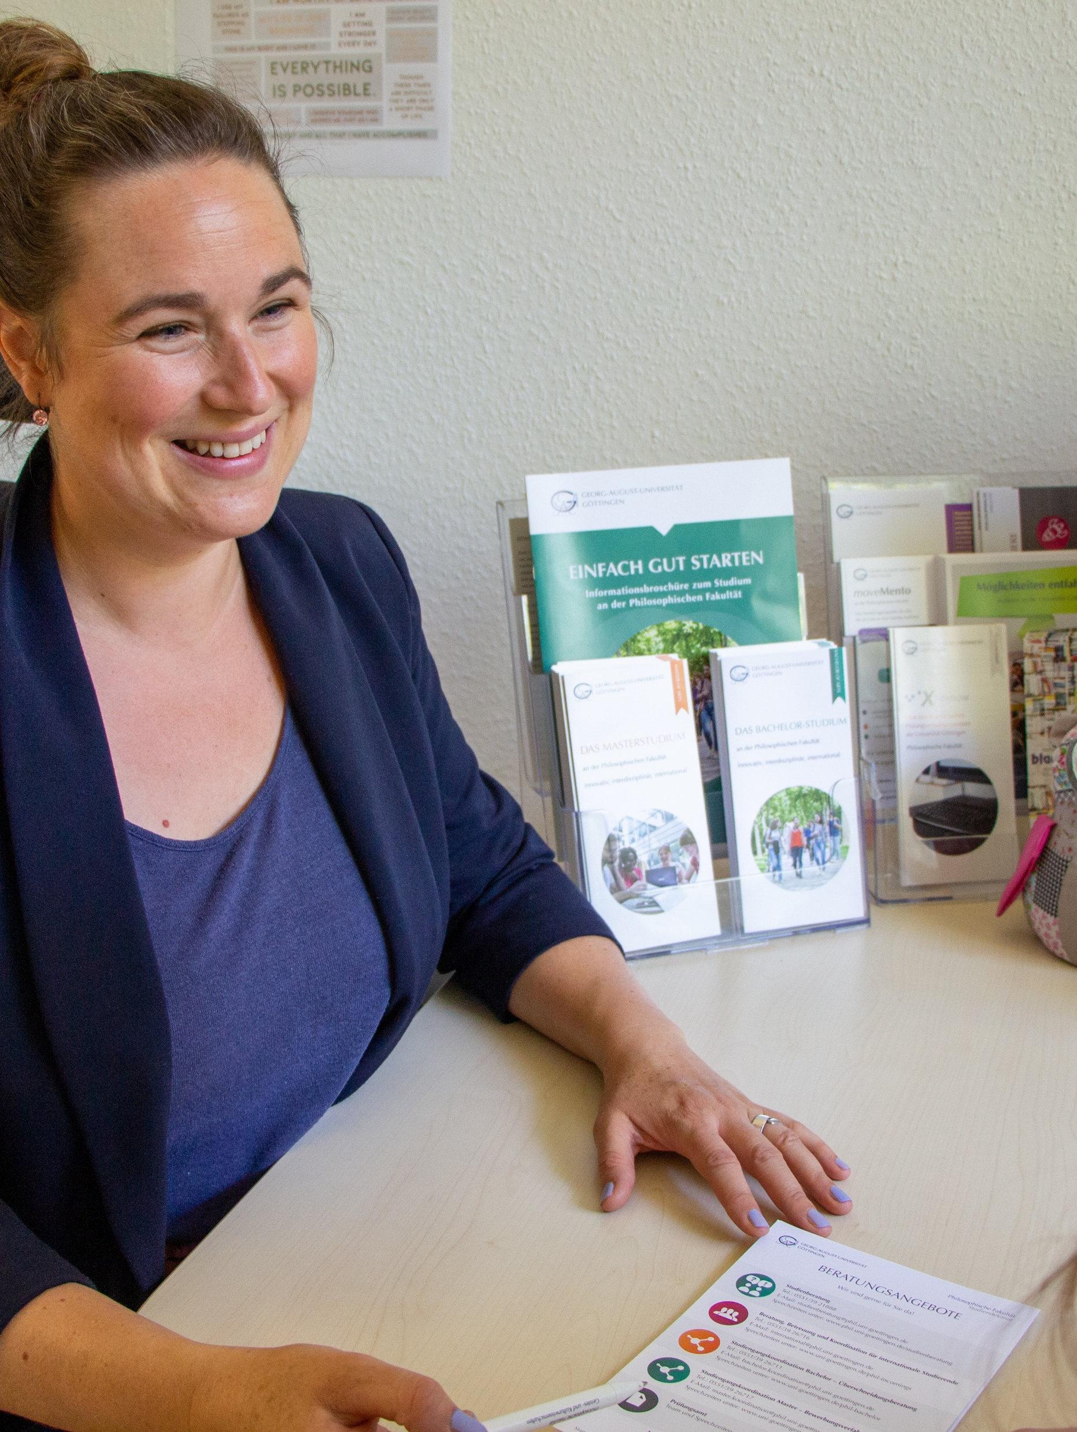
Contact points for questions
Who do I contact?

Slide 25
Who do I contact if I have questions or difficulties?
Subject-specific questions, e.g. on the recognition of achievements or on courses and modules
Student counselling for your subject : https://www.uni-goettingen.de/en/562355.html
Interdisciplinary questions, e.g. on creating a timetable/study plan, on the professionalisation area or on changing subjects & in case of study doubts
Study and examination counselling of the Faculty of Arts and Humanities: https://uni-goettingen.de/en/111037.html
Help with timetable: https://uni-goettingen.de/en/448227.html
Recognition of examination results: https://uni-goettingen.de/en/677784.html
Professionalisation area and key competencies : https://www.uni-goettingen.de/en/366104.html

Slide 26
Who do I contact if I have questions or difficulties?
For general questions about studying, e.g. whether studying is the right choice at all
Central Student Counselling Service : https://www.uni-goettingen.de/en/1697.html
In the event of psychological stress or difficulties during your studies
Psychosocial counselling centre : https://www.studierendenwerk-goettingen.de/en/social-and-psychosocial-counselling/psb

Slide 27
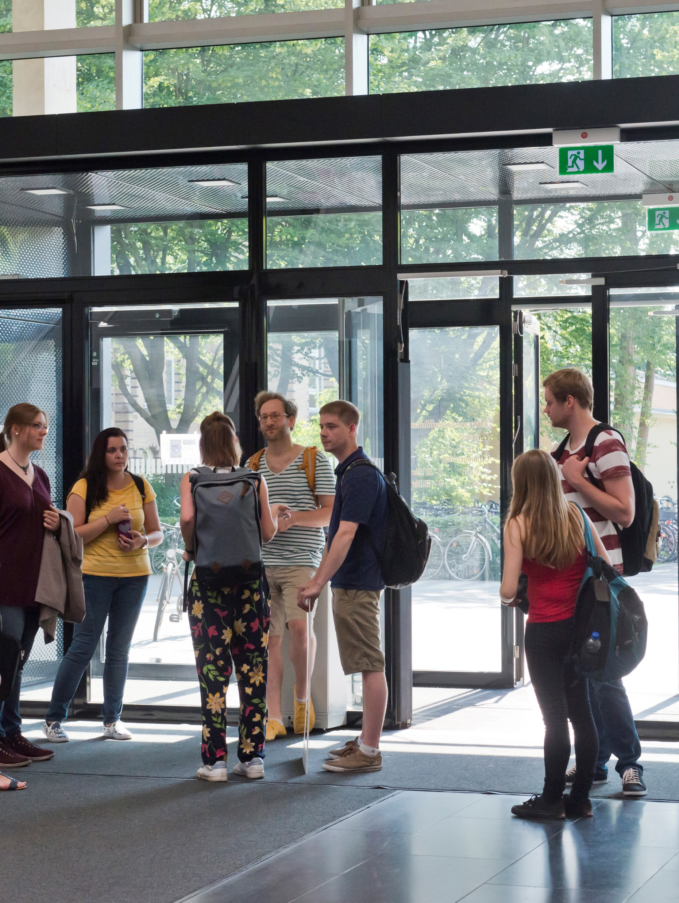
Contact lecturer
For questions about the course, examination or content
How to reach me:
E-Mail:
Tel:
Office Hours:
Website:

